Slide 1
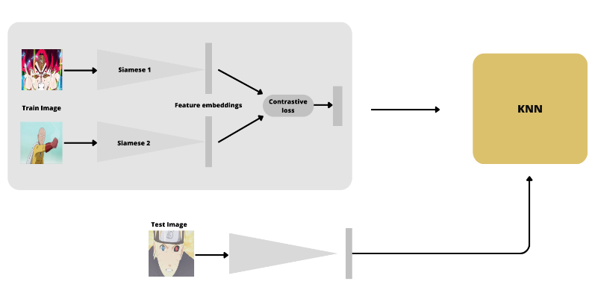
«Shazam Anime» : Siamese-ResNet50 neural network
In the course of this project, we tried to realize a system capable of recognizing the title of an anime from a single frame. Through the proposal of a Siamese-ResNet50 network, which combines a Siamese network structure with the well-known ResNet architecture, we evaluate the effect of its use starting from a pre-training on ImageNet public data collection.

Slide 2
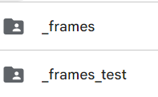
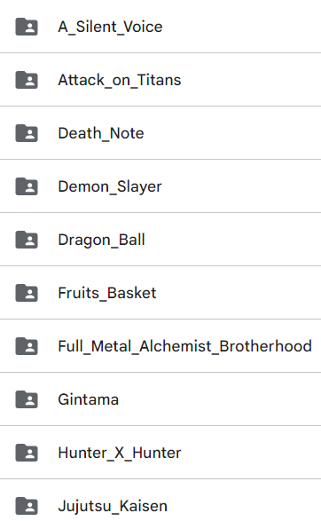
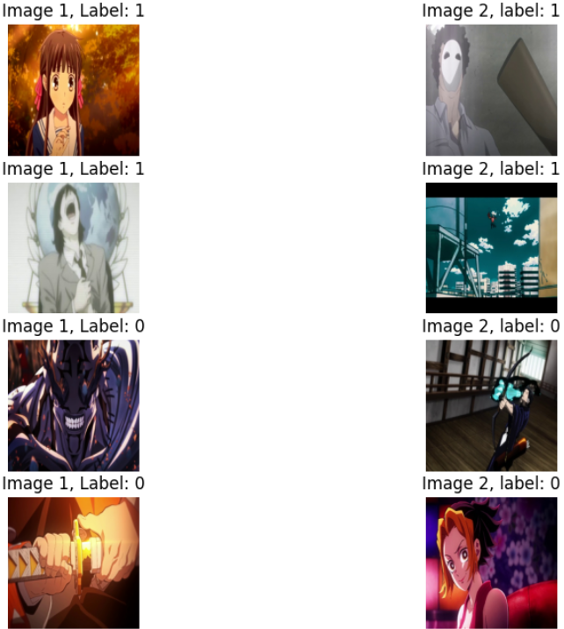

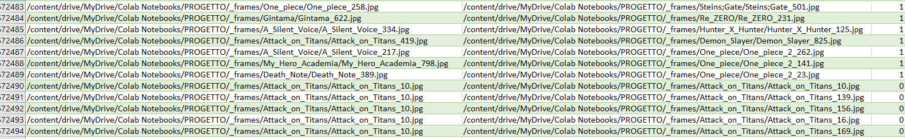
Datasets: Siamese and classifier
Images folders
Siamese_ds_balanced
Ds dataset classifier
CSV Siamese paths

Slide 3
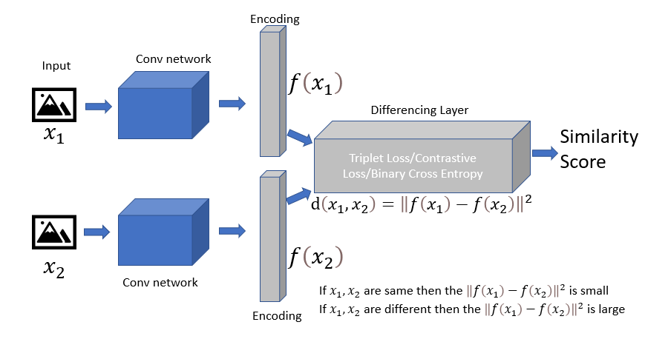
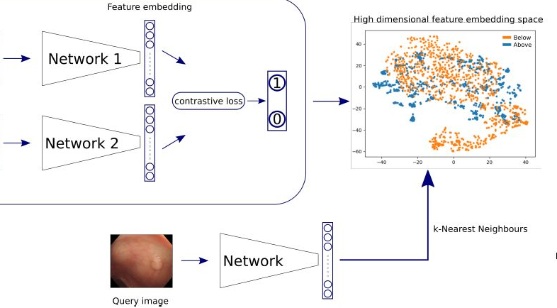

Method and approach
Siamese neural network
K-NN classifier / Dense classifier
Loss function : contrastive loss
Similarity function : euclidean distance
Networks : ResNet50 / VGG16
Model surgery : cutted trained Siamese network
Features extractor : one-Siamese-branch (features vectors)
Classification : K-NN classifier or trained Dense layer classifier; 16 classes

Slide 4
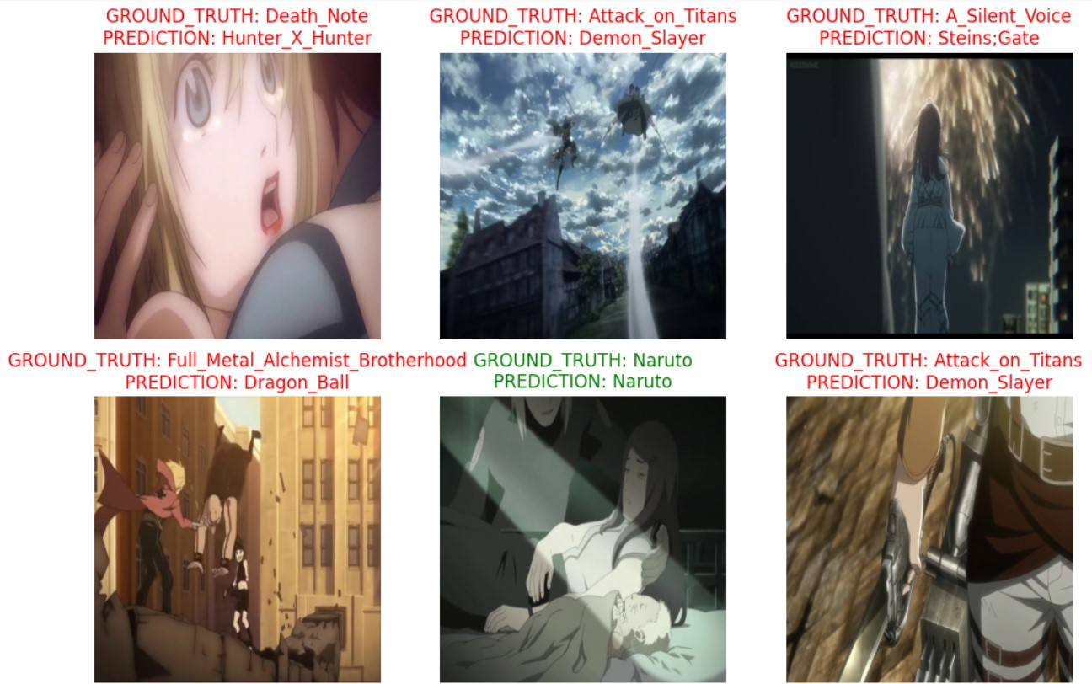
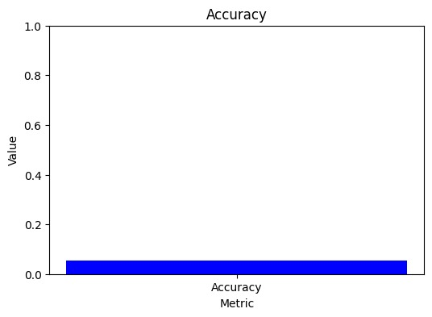
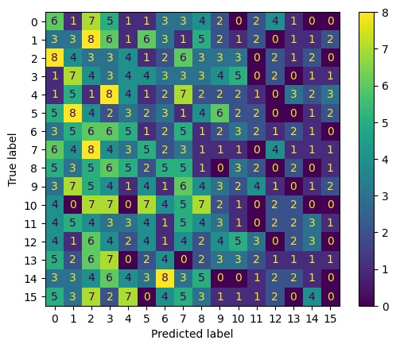
K-NN main results (ResNet50)
K-NN results
Metrics
Ground truth : test labels of the main dataset
Prediction: k-NN predicted label
Query image: test images passed via the Siamese branch (features extractor)
Bad results of accuracy and prediction
Total accuracy: really low accuracy
Confusion matrix: notice random results
Network adopted: Siamese-ResNet50 with k-NN classifier/Dense layer

Slide 5
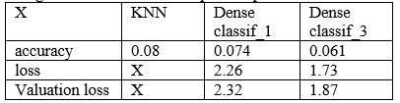
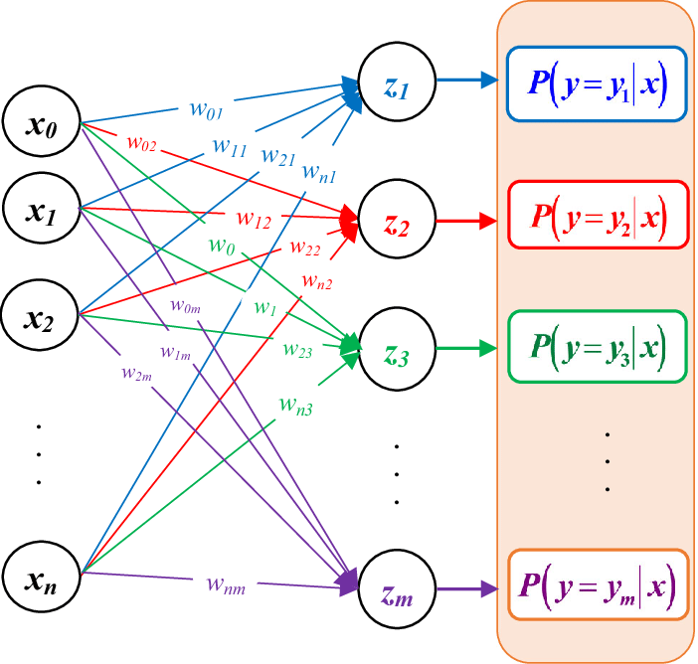
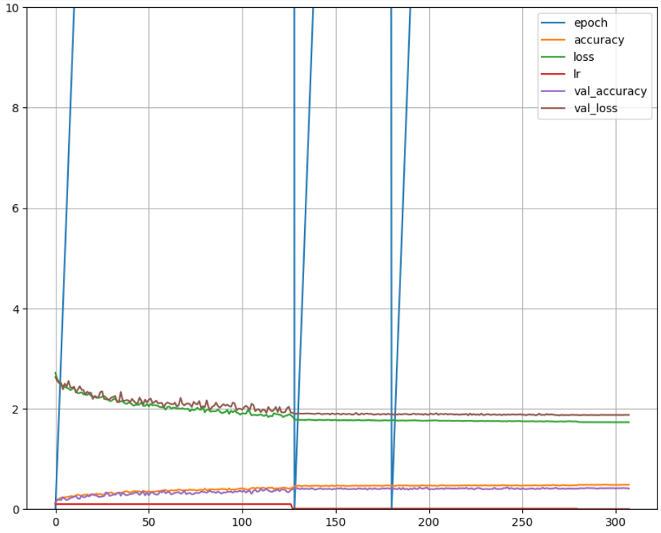
Dense classifier main results
Dense classifier results
Dense classifier architecture
Activation function: softmax with sum of probabilities to one
Dense layer Confusion matrix obtains the same results of k-NN, although k-NN gives the best result without success

Slide 6

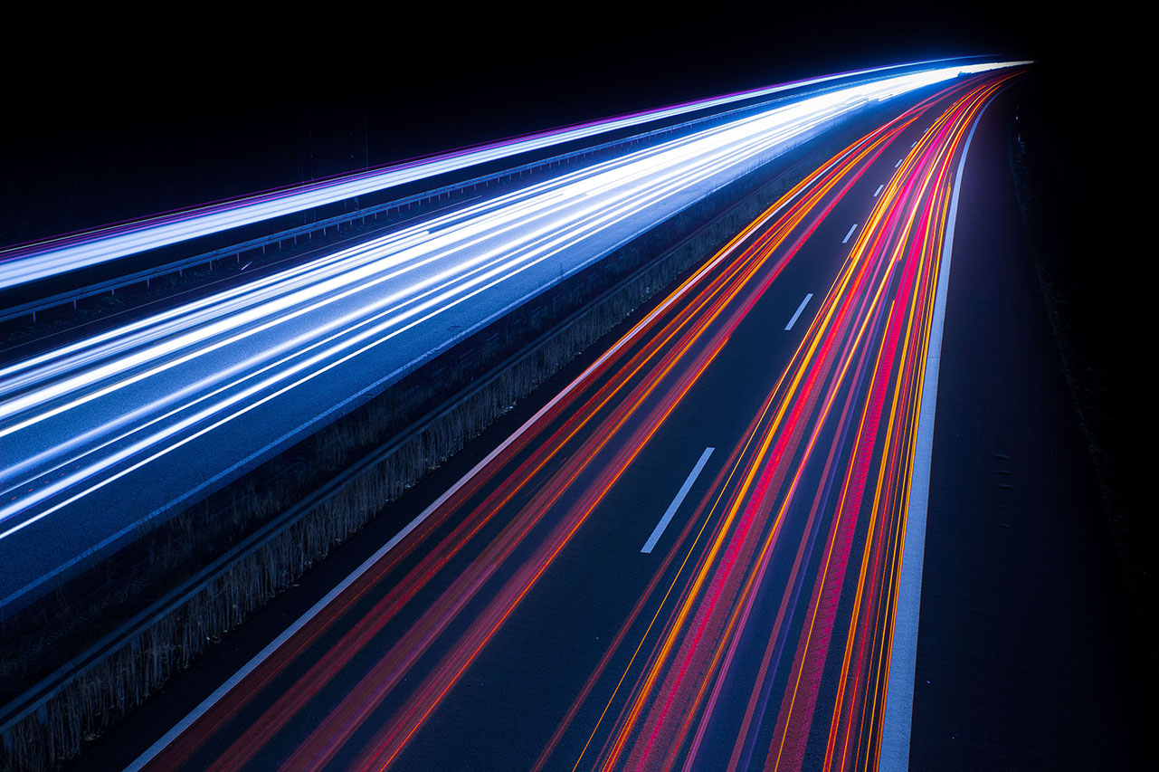
Thank you!
Alessandro bresciani 305903
Luca Filippetti 303392

